Slide 1

Linux File System(FS)

Slide 2
FS are the mechanisms by which the data on a storage medium gets organized.
They provide all of the abstraction layers above sectors and cylinders of disks.

Slide 3
What is a file
UNIX expands the usual defn of a file to include anything from which data can be taken or to which data can be sent.
It can also refer to the various I/O devices (keyboard, printer ect)
Since that describes virtually everything the OS deals with, it is often said that everything is a file in UNIX

Slide 4
Three general kinds of UNIX files
Ordinary files:- – These are the common computer files
Special files :- Also called device files, special files represent physical devices such as terminals, printers and other peripherals.
Directory files:- Ordinary and special files are organized into collections called directory files or directories

Slide 5
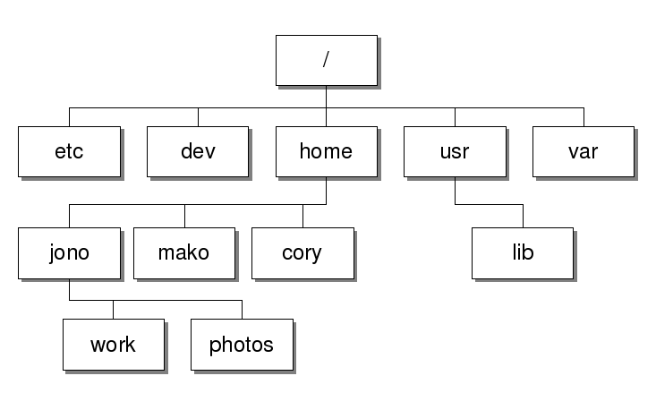
Linux Hierarchical File system

Slide 6
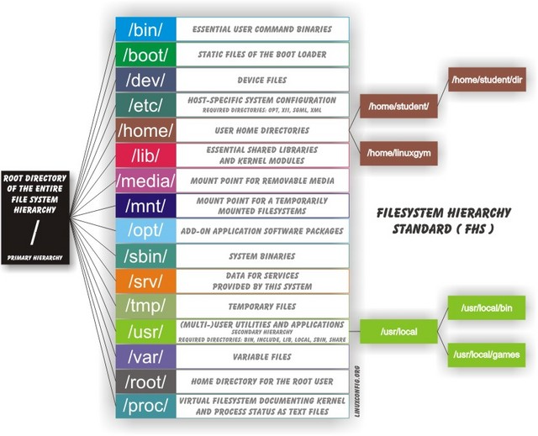

Slide 7
When a file system is created, data structures are created that contain information about files
Each file is associated with an inode that is identified by an inode number (often referred to as an "i-number" or "inode") in the file system where it resides.

Slide 8
Unix directories and files don't really have names. They are numbered, using node numbers called inodes, vnodes, or even gnodes
All the name-to-number mappings of files and directories are stored in the parent directories

Slide 9
For each file or directory, a link count keeps track of how many parent directories contain a name-number mapping for each node.
When a link count goes to zero, no directory points to the node and Unix is free to reclaim the disk space.

Slide 10
The inode (index node) is a fundamental concept in the Linux and UNIX filesystem. Each object in the filesystem is represented by an inode
Each object in the filesystem is represented by an inode.
But what are the objects?
Each and every file under Linux (and UNIX) has following attributes:

Slide 11
=> File type (executable, block special etc) => Permissions (read, write etc) => Owner => Group => File Size => File access, change and modification time => File deletion time => Number of links (soft/hard) => Extended attribute such as append only or no one can delete file including root user (immutability) => Access Control List (ACLs)

Slide 12
All the above information are stored in an inode. In short the inode identifies the file and its attributes (as above) .
Each inode is identified by a unique inode number within the file system. Inode is also know as index number.

Slide 13
inode definition
An inode is a data structure on a traditional Unix-style file system such as UFS or ext3. An inode stores basic information about a regular file, directory, or other file system object.
Unix directories are lists of "link" structures, each of which contains one filename and one inode number.

